Slide 1
ActivitySim Task 2:
Vehicle Type Choice Model
Mark Bradley, RSG
Greg Erhardt, U. of Kentucky
July 13, 2021

Slide 2
Task objectives
This is the first time a vehicle type choice model will be incorporated into an ActivitySim, DaySim, CT-RAMP or TourCast model.
The objectives are:
To implement a fully functional vehicle type choice model to work with the ActivitySim example model specification.
To also include a simple model to allocate vehicles to auto trips, for use in GHG/emissions modeling.
To make the model extendable in several different ways as part of future ActivitySim development work by RSG and/or others.

Slide 3
Choice of a data set for model estimation
Survey | NHTS National | NHTS Caltrans | SANDAG HTS | SACOG HTS | SFCTA / MTC Tnc
Years | 2016-17 | 2016-17 | 2016-17 | 2018 | 2018-19
Households (approx.) | 130,000 | 26,000 | 6,200 | 4,000 | 4,500
Vehicles (approx.) | 256,000 | 52,000 | 10,000 | 6,600 | 5,500
Body type coded? | Yes | Yes | No | No | No
Fuel type data complete? | Yes | Yes | Yes, but no QA/QC | Yes, but no QA/QC | No
Commute and trip distances available? | Yes | Yes | From GIS and skims | From GIS and skims | From GIS and skims
Residence land use and area type data | Census BG densities | Census BG densities | From GIS and ACS | From GIS and ACS | From GIS and ACS
Travel data for full hh? | Yes | Yes | Yes | Yes | No
Publicly available | Yes | No | No | No | No
Representative for… | US, region | CA, region | region | region | region

Slide 4
Proposed vehicle types: combination of body type, fuel type, and age group.
 | Cases | %
auto | 122,391 | 47.8
van | 13,184 | 5.1
SUV | 60,353 | 23.6
pickup/truck | 47,646 | 18.6
motorcycle | 9,283 | 3.6
RV/ other/ missing | 3,258 | 1.3
Total | 256,115 | 100.0
 | Cases | %
gas | 241,759 | 94.4
diesel | 7,422 | 2.9
HEV | 4,996 | 2.0
PEV | 607 | .2
PHEV | 482 | .2
other/missing | 849 | .3
Total | 256,115 | 100.0
 | Cases | %
<5 yrs (2012-2017) | 82,849 | 32.3
5-10 years (2007-2011) | 61,872 | 24.2
>10 years (pre-2007) | 111,394 | 43.5
Total | 256,115 | 100.0

Slide 5
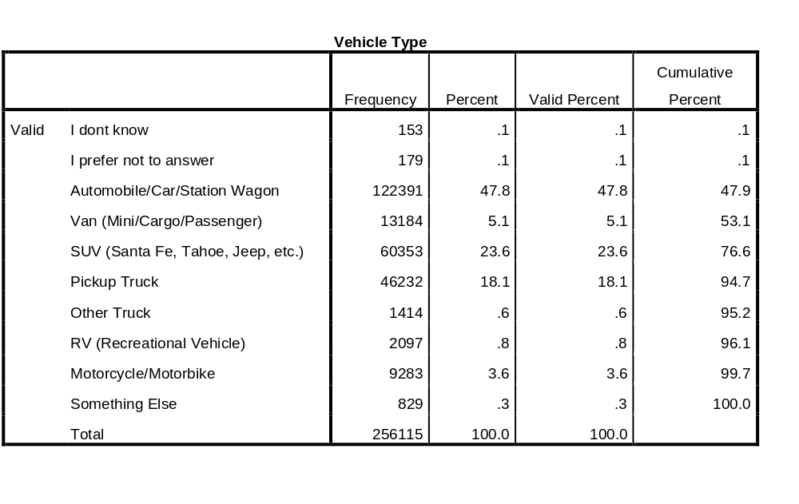
Detailed body type answers. RV’s grouped with “other/missing” because they are rarely used for within-region weekday trips.

Slide 6
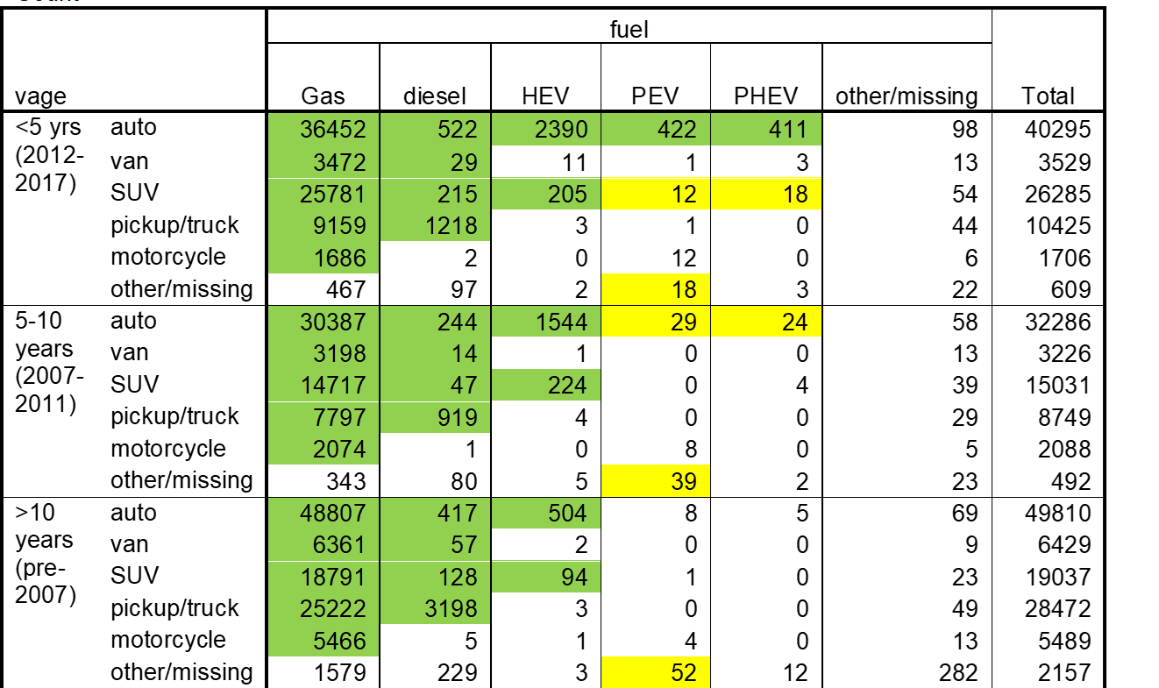
Proposed vehicle types: combination of body type, fuel type, and age group

Slide 7
Options for model structure
Use nested logit, possible nesting by fuel type, body type, age group
Option 1: Model the choice for each vehicle in a household independently.
Option 2: Set priority order across all vehicle type alternatives, order vehicles by priority, and model each choice conditionally on previous choice(s). No choice can be higher priority than previous choice within the same HH. For example, if PEVs are set as highest priority, then once a non-PEV is chosen, PEV’s are no longer available.
Option 3: Vehicle choice is linked to vehicle’s main driver as reported in the survey, with driver’s sorted in priority order (e.g. by ActivitySim person type). This requires a simple model of which HH members are main drivers. We can then consider person attributes (such as men driving pick-up trucks).
Options 3 and 2 are preferable to get realistic vehicle type combinations within HH. Option 3 is recommended – has downstream advantages.

Slide 8
Proposed explanatory variables
Number of vehicles in HH (separate model in ActivitySim)
Number of HH members in 8 main ActivitySim person types:
  full-time working adults
  part-time working adults
  university students
  non-working adults aged <65
  non-working adults aged 65+
  (other) children aged 16+
  children aged 5-15
  children aged 0-4
Commute distances for workers, students
HH income
Residence area land use (based on Census BG pop. & emp. densities)
Metropolitan area size / presence of commuter rail
Metropolitan area-specific dummies(?)
Person attributes of main driver (for Option 3)
Vehicle types already chosen.
To also include a simple model to allocate vehicles to auto trips, for use in GHG/emissions modeling.
To make the model extendable in several different ways as part of future ActivitySim development work by RSG and/or others.

Slide 9
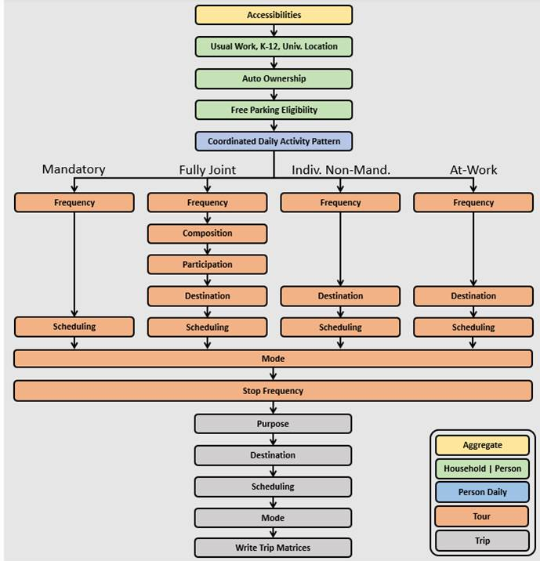
Where the model fits in the ActivitySim structure
INPUT variables are the same as for Auto Ownership, plus the number of HH autos predicted (0, 1, 2, 3 or 4).
OUTPUT variables for each auto:
Body type
Fuel type
Age range (could be stochastically assigned to a specific year)
Person ID of main driver
These can either be in a new auto output file or be added as new fields in the HH file for up to 4 vehicles.
For each vehicle..
Main driver
Vehicle type

Slide 10
Notes on Forecasting and Scenario Analysis
This model will be estimated from base-year data with low penetration of alternative fueled vehicles, especially PEV/PHEVs. Given the variables we can estimate, we would expect this to continue in future predictions. However, we might expect the penetration to change if:
More manufacturers produce PEVs, increasing the supply and options.
The distance range of PEVs increases substantially
The available number of charging locations increases.
PEV/PHEVs become less expensive.
Gasoline prices increase or decrease.
Because there is little to no variation of these terms in a cross-sectional survey, we cannot estimate their effect directly.
The best source for these variables is likely to be asserted coefficients based on modeling done by RSG for the California Energy Commission, based on both SP and RP data.
Any variables not included explicitly will be “baked into” the alternative-specific constants, and these can be varied in scenarios.

Slide 11

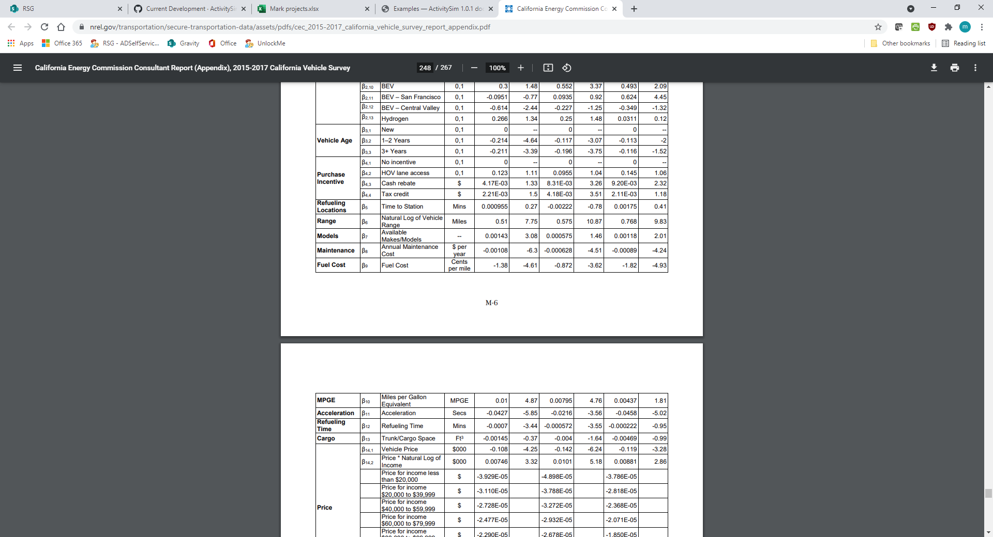
Adding effects of vehicle price and fuel price changes, and additional EV-related variables
Best source is likely to be asserted coefficients based on modeling done by RSG for the California Energy Commission, based on both SP and RP data. (https://www.nrel.gov/transportation/secure-transportation-data/assets/pdfs/cec_2015-2017_california_vehicle_survey_report_appendix.pdf)

Slide 12
Simple model to allocate vehicles to tours
This subtask was not requested in the RFP, but we are including it
to make the aggregate model output useful for VMT and emissions modeling.
More complex vehicle allocation and scheduling models can be part of future ActivitySim development work.
Approach: The choice of which vehicle to use on any tour is modeled independently across tours within a HH. It is applied before the tour mode choice simulated, so that the vehicle type can be used to condition the auto utility.
Choice set: The vehicles owned by the HH (from the vehicle type choice model), plus the additional choice of using a non-HH vehicle
Explanatory variables
Primary driver of each vehicle (if known from Option 3 above)
Fuel type, body type, age of HH vehicles
Tour purpose
Tour destination land use/area type
Tour distance
Tour scheduled duration (including activities)

Slide 13
Where the model fits in the ActivitySim structure
INPUT variables are the same as for tour Mode choice, plus the outputs from the vehicle type model.
New OUTPUT variable for tours:
ID of HH vehicle used (if relevant)
Can be tied back to vehicle or HH file.
Complicating factors
There may be more than one driver on a tour in the survey data. (Select the one that drives longest distance as the main driver.)
ActivitySim does not predict who is a driver or a passenger on the tour. (If the person is a main driver for any HH vehicle, assume they are the driver for the tour.)
ActivitySim only predicts which other HH members are occupants for fully joint tours. (Use joint tour details when they are useful)
For each vehicle..
Main driver
Vehicle type
Which vehicle will be used for the tour if the auto mode is chosen?

Slide 14
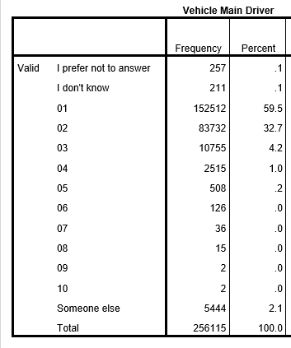
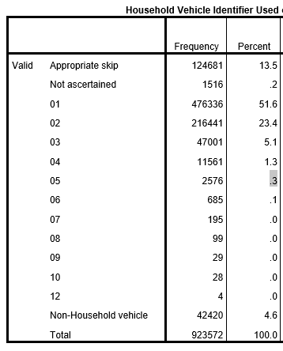
NHTS data on main driver of each vehicle and vehicle used on each trip is very complete

Slide 15
Percent of HH-vehicle trips where the main driver of the vehicle was the driver on the trip, by number of vehicles and drivers in the HH
 | ndrivers
ncars | 1 | 2 | 3 | 4+ | Total
1 | 99% | 79% | 72% | 64% | 94%
2 | 98% | 85% | 78% | 72% | 86%
3 | 97% | 85% | 86% | 75% | 85%
4+ | 97% | 85% | 85% | 86% | 86%
Total | 99% | 84% | 84% | 83% | 88%
There are fewest % of matches when there is 1 vehicle and more than 1 driver in the HH, but in those cases there is only 1 vehicle to choose.
The simple vehicle allocation model will be useful when there are 2+ household vehicles and 2+ drivers. In those cases, knowing the main driver of each vehicle still very useful in explaining which vehicle is used, but there is some substitution within the HH based related tour purpose, duration and distance.

Slide 16
Some possible future extensions
Vehicle type choice
Use more integrated variables such as mode choice logsums to represent accessibility differences between different vehicle types. (Important if certain vehicle types are treated differently on networks, such as EV’s being allowed to use HOV lanes. Would best be done using data from a new HTS and the internal ActivitySim model estimation functionality.)
Possibly model number of vehicles and vehicle types simultaneously.
Estimate models using data from surveys spanning multiple years (e.g. NHTS 2017, 2021, 2023, etc.). to capture variation in available PEVs, price of PEVs, etc.
Extend the vehicle types to include CV/AV’s
Vehicle allocation
Integrate the vehicle allocation model more fully into a joint tour mode choice/vehicle allocation model to make fuel cost and perhaps other factors a function of the vehicle type, vehicle occupancy, distance, etc.. (Requires more extensive programming work.)
Enhance the vehicle allocation model to include vehicle scheduling—a vehicle can only be in one place at a time. (Requires extensive programming work. Also requires a full household travel survey with complete travel data for all HH members.)

Slide 17

Contacts
Mark Bradley
Senior Director
Mark.Bradley@rsginc.com
www.rsginc.com

Slide 18
Simple model to allocate vehicles to trips
This subtask was not requested in the RFP, but we are including it
to make the aggregate model output useful for VMT and emissions modeling.
More complex vehicle allocation and scheduling models can be part of future ActivitySim development work. Ideally, this would be modeled at the tour level as a joint tour mode choice/vehicle allocation model,
Approach: The choice of which vehicle to use on any trip is modeled independently across auto trips within a HH (and even within the same tour).
Choice set: The vehicles owned by the HH (from the vehicle type choice model), plus the additional choice of using a non-HH vehicle
Explanatory variables
Primary driver of each vehicle (if known from Option 3 above)
Fuel type, body type, age of HH vehicles
Trip distance
Trip origin and destination purposes
Trip auto occupancy (SOV, HOV2, HOV3+)

Slide 19
Where the model fits in the ActivitySim structure
INPUT variables are all of the predicted attributes of each trip.
New OUTPUT variable for trips:
ID of HH vehicle used (if relevant)
Can be tied back to vehicle or HH file.
Complicating factor
ActivitySim does not predict who is a driver or a passenger on the trip. Chance of the person being the (main) driver is a function of trip occupancy.
For each vehicle..
Main driver
Vehicle type
Which vehicle will be used for the trip?

Slide 20
More complex model to allocate vehicles to tours
This subtask was not requested in the RFP, but we are including it
to make the aggregate model output useful for VMT and emissions modeling.
More complex vehicle allocation and scheduling models can be part of future ActivitySim development work.
Approach: The choice of which vehicle to use on any tour is modeled independently across tours within a HH. It is applied whether or not the tour mode is auto, so that the vehicle type can be used to condition the auto utility
Choice set: The vehicles owned by the HH (from the vehicle type choice model), plus the additional choice of using a non-HH vehicle
Explanatory variables
Primary driver of each vehicle (if known from Option 3 above)
Fuel type, body type, age of HH vehicles
Tour purpose
Tour distance
Tour scheduled duration (including activities)
Auto choice alternative occupancy (SOV, HOV2, HOV3+)

Slide 21
Where the model fits in the ActivitySim structure
INPUT variables are the same as for tour Mode, plus the outputs from the vehicle type model.
New OUTPUT variable for tours:
ID of HH vehicle used (if relevant)
Can be tied back to vehicle or HH file.
Complicating factors
Several variables are conditional on vehicle occupancy, so the model needs to be applied for each occupancy alternative.
There may be more than one driver on a tour in the survey data. (Use one that drives longest dist.)
ActivitySim does not predict who is a driver or a passenger on the tour. Chance of the person being the main driver is a function of occupancy.
ActivitySim only predicts which other HH members are occupants for joint tours.
For each vehicle..
Main driver
Vehicle type
Which vehicle will be used for the tour if the auto mode is chosen, for SOV, HOV2, HOV3+ alternatives?

