Slide 1
Transit Pass Ownership Model Estimation
ActivitySim Weekly Meeting
April 27, 2021

Slide 2
Data for estimation
California Household Travel Survey for MTC
  9,719 households
  23,948 persons
Data collected transit pass ownership at person level, type of pass owned, whether pass was subsidized, and amount of subsidy
Most complete dataset with respect to transit pass ownership and largest sample size in a region with several transit options

Slide 3
Transit pass type
Transit pass type | Freq. | Percent
BayArea Clipper Card (Clip) | 747,034 | 62%
San Diego Compass Card (Comp) | 1,085 | 0%
Tap Card or EZ Transit Pass | 17,557 | 1%
Other local bus pass | 126,729 | 11%
Other express/ commuter bus pass | 17,166 | 1%
Other light rail/subway/train/ streetcar | 51,860 | 4%
Dial-a-ride/paratransit pass | 16,643 | 1%
Ferry/boatpass | 6,991 | 1%
Other (specify) | 177,201 | 15%
DK | 33,134 | 3%
RF | 4,009 | 0%
Total | 1,199,410 | 100%
Many different types of transit passes (~30 transit operators in region)
Some persons have multiple passes
Each pass has different types of discounts (seniors, students, etc.)
About ½ of Clipper Card owners have a transit pass loaded on their card
On-board survey data could be used to estimate average fare paid based on pass type used

Slide 4
Amount of subsidy
Subsidy has the effect of reducing perceived fare
Subsidy converted to daily and compared to work or school round-trip fare from best walk-transit path
  Work fare used if person type = full-time or part-time worker, else school fare used.
  Capped at 100%
Transit subsidy unit | Freq. | Percent | Conversion to daily
Per hour | 3 | 0.36 | subsidy * 24
Per day | 35 | 4.2 | NA
Per week | 32 | 3.84 | subsidy * 1/5
Per month | 333 | 39.98 | subsidy * 1/22
Per semester | 29 | 3.48 | subsidy * 1/(4*22)
Per year | 64 | 7.68 | subsidy * 1/(12*22)
Other (specify) | 32 | 3.84 | various
DK | 238 | 28.57 | NA
RF | 67 | 8.04 | NA
Total | 833 | 100

Slide 5
Daily subsidy compared to round-trip mandatory fare
Average subsidized percent = 49%

Slide 6
Data for estimation
Household and person attributes
  Income, person type, industry
Mobility attributes to work and school commute (from TM2)
  Auto generalized time (autoGenTime = time + (dist*cpm + tolls)/vot*60)
  Transit generalized time (in-vehicle time + 1.5*(walk time + first wait time)+2*transfer wait time + 10*transfers + fare*100/vot*60)
  Auto minus transit generalized time (higher should be + for transit pass ownership)
  Availability of rail in path
Household transit accessibility
  Destination choice logsum from household microzone to non-mandatory activities by off-peak walk-transit
Notes: cost per mile (cpm) = 17.23 cents; Value of time (VOT) = $15/hour; best walk-transit path used for transit skims

Slide 7
Model structure
Transit Subsidy
Yes
No
Choice
Yes
Fully subsidized
No
Partially subsidized
Not subsidized
Transit Pass
Yes
No
Original proposal
Estimated models
Not possible to identify fully subsidized pass ownership from data

Slide 8
Transit Subsidy Model
Variable | Subsidy offered
Variable | Coeff | T-stat
Person type
Full-time worker | 1.8827 | 11.9428
Part-time worker | 1.3607 | 7.6086
University/College | 2.0270 | 10.6879
Industry
NAICS 70 (Entertain,accom) | -0.6596 | -2.8966
NAICS 80 (Other services) | -0.3526 | -1.4742
NAICS 90 (Public admin) | 0.8650 | 7.7186
Transit accessibility to households | 0.0496 | 3.6835
Daily parking cost (dollars) | 0.0601 | 11.5171
Constant | -5.1380 | -40.6614
Full-time workers, part-time workers, and university students more likely to have subsidized transit
Entertainment/accommodations and other services workers less likely to have subsidized transit
Public administration workers more likely to have subsidized transit
Workers who work in more transit accessible locations more likely to have subsidized transit
Parking cost is positively correlated with subsidized transit

Slide 9
Transit Pass Model
Variable | Transit Pass Owned
Variable | Coeff | T-stat
Person type
Full-time worker | 2.0347 | 18.1726
Part-time worker | 1.9345 | 16.3144
University/College | 2.3878 | 18.8417
Non-working adult | 1.5207 | 12.8244
Retired | 1.9639 | 16.8226
Household Income
0-$9k | 0.6098 | 4.3813
$10-$24k | 0.4220 | 4.7381
$25-$34k | 0.2120 | 2.2471
$35-$49k | 0.1392 | 1.7237
$250k+ | -0.1700 | -1.9301
Refused
Industry
NAICS 20 (mining, utilities, construct) | -0.3247 | -2.4728
NAICS 30 (manufacturing | -0.4732 | -3.2925
NAICS 50 (Info, Fin/insur, real estate, prof/sci/tech,manage,admin) | 0.2731 | 4.5210
NAICS 70 (Entertain,accom) | 0.2194 | 2.0181
NAICS 80 (Other services) | -0.5853 | -3.6629
NAICS 90 (Public admin) | 0.3041 | 3.0151
Auto minus transit time (work) | 0.0019 | 6.2499
Subsidy offered | 1.9676 | 25.6810
Constant | -3.9329 | -38.2630

Slide 10
Transit Pass Model Results
Full-time, part-time workers, college students, retired more likely to own transit pass. Non-working adults more likely than children to own passes.
Household income negatively correlated with pass ownership
Resource extraction, manufacturing and other services workers less likely to own a transit pass
Financial, accommodations, and public sector employees more likely to own a transit pass
Transit pass ownership more likely as transit accessibility compared to auto accessibility improves
Persons with subsidized transit are more likely to own a transit pass

Slide 11
What about interaction of transit pass with parking pass/free parking?
Employer provided parking/reimbursement not asked in recruitment survey
Place survey
  How much did you pay to park?
  What parking type did you use (credit card, cash, employer pass, etc.)?
  How much did you pay out-of-pocket that was not reimbursed?
Messy data
  346 cases where “not reimbursed” amount greater than “amount paid” out of 782 total cases with a “not reimbursed” amount greater than zero
  When merged with person data, no conclusions could be drawn regarding interaction due to small sample and data issues

Slide 12
Calculation of perceived transit fare
Segment | No Subsidy | Subsidy
No Pass | Cash fare * cash discount factor | Cash fare * cash discount factor * (1-subsidy percent)
Pass | Cash fare * pass discount factor | Cash fare * pass discount factor * (1-subsidy percent)
Where:
Cash fare: skimmed fare (includes transfer fare)
Cash discount factor: the ratio of average value of a discounted cash fare to full cash fare for certain person types (seniors, students)
Pass discount factor: the ratio of average value of a discounted transit pass to full cash fare
Subsidy percent: the average percent reimbursement of the cash fare for persons who receive a transit subsidy

Slide 13
Calculation of transit pass value
SEMCOG on-board survey data used
  Conducted fall 2018/spring 2019
  17927 completed surveys
  Included multiple operators
    Detroit Department of Transportation (DDOT)
    Suburban Mobility Authority for Regional Transportation (SMART)
    Ann Arbor Transportation Authority (AAATA)
    University of Michigan
    Detroit People Mover
    Q Line (streetcar)
    Blue Water Area Transit, Lake Erie Transit, MTA Flint

Slide 14
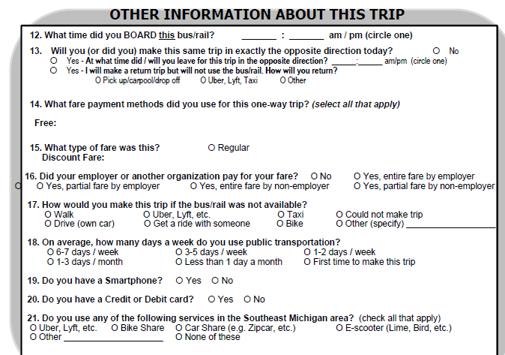
Relevant data
Pass ownership, type of pass, fare paid
Subsidy
Convert weekly/monthly value to per trip value

Slide 15
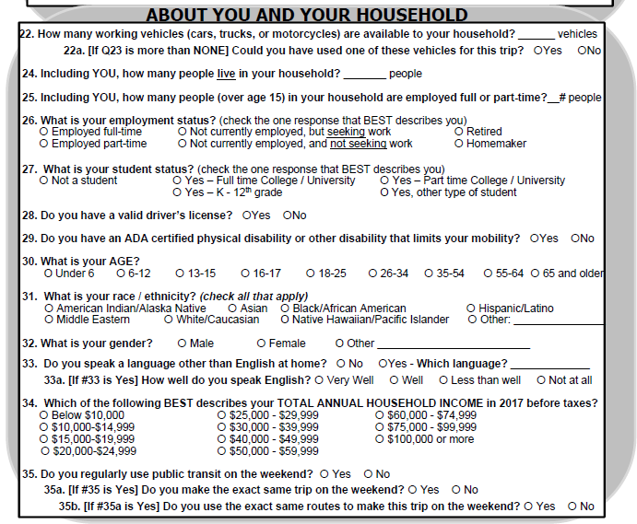
Relevant data (con’d)
Person type

Slide 16
Steps
Code pass ownership variable
Calculate average number of transit trips per day/week/month/semester based on transit frequency responses for transit pass owners
Code transit pass value (requires looking up values)
Convert pass value to per trip value using transit frequency
Code cash fare
Calculate discount percent based on transit fare code
Code person type
Summarize ratios by person type and operator

Slide 17
Transit Pass Ownership
Included weekly, monthly, semester passes
Did not include
  Multiple hour passes
  Daily passes
  Two day passes (discontinued)
  Special event passes
For each pass type
  Looked up value of pass
  Divided value of pass by average number of transit trips for pass period based on transit frequency response for pass holders

Slide 18
Transit trips by transit pass ownership
Person Type | No pass | Pass owned | No pass | Pass owned
Full-time worker | 40,169 | 21,063 | 66% | 34%
Part-time worker | 10,388 | 3,445 | 75% | 25%
College/University student | 6,545 | 36,440 | 15% | 85%
Non-working Adult | 9,267 | 3,254 | 74% | 26%
Retired Adult | 2,310 | 1,475 | 61% | 39%
Driving-age student | 1,638 | 1,296 | 56% | 44%
Non-driving age student | 1,141 | 604 | 65% | 35%
Total | 71,459 | 67,578 | 51% | 49%
Transit trips made by college/university students most likely to use transit passes (85%)
Transit trips made by part-time workers and non-working adults are least likely to use transit passes (25%-26%)

Slide 19
Transit trips by frequency of transit usage
TRANSIT_USE_FREQ | Freq. | Percent | Average transit use per week
1-2 days / week | 4,188 | 6% | 1.5
1-3 days / month | 803 | 1% | 0.5
3-5 days / week | 40,254 | 60% | 4.0
6-7 days /week | 22,013 | 33% | 6.5
First time to make this trip | 146 | 0% | 1.0
Less than 1 day a month | 174 | 0% | 1.0
Total | 67,578 | 100% | 4.6
Trips per day (asserted) |  |  | 2
Trips per week |  |  | 9.2
Trips per month |  |  | 39.5
Table is for transit pass holders only
Transit trips per week and month used to scale transit pass costs to per trip value

Slide 20
Transit pass value
Pass type | Cost | Scaling Factor | Cost per trip
DDOT_5DAY_PASS | $ 14.40 | 10 | $ 1.44
DDOT_BIWEEKLY_GOPASS | $ 27.50 | 20 | $ 1.38
DDOT_WEEKLY_GOPASS | $ 14.40 | 10 | $ 1.44
DDOT_MONTHLY_GOPASS | $ 47.00 | 40 | $ 1.18
DDOTSMART_REGIONAL_MONTHLY_PASS | $ 49.40 | 40 | $ 1.24
SMART_31_DAY_PASS | $ 66.00 | 40 | $ 1.65
SMART_REGIONAL_PASS | $ 49.50 | 40 | $ 1.24
SMART_REGIONAL_PLUS_PASS | $ 69.50 | 40 | $ 1.74
AAATA_FREE__UNIVERSITY_OF_MICHI | $ - | NA | $ -
AAATA_FREE__ARIDE | $ - | NA | $ -
AAATA_FREE__GOLDRIDE | $ - | NA | $ -
AAATA_FREE__WCC_CARD | $ - | NA | $ -
AAATA_EMU_STUDENTS_30_DAY_CARD | $ - | NA | $ -
AAATA_FARE_DEAL_CARD | $ 29.00 | 40 | $ 0.73
Q_LINE_MONTHLY_PASS | $ 50.00 | 40 | $ 1.25
Q_LINE_ANNUAL_PASS | $ 50.00 | 40 | $ 1.25
DPM_MONTHLY_PASS | $ 10.00 | 44 | $ 0.23
DPM_ANNUAL_PASS (per month cost used) | $ 10.00 | 44 | $ 0.23
BW_10DAY_PASS | $ 10.50 | 20 | $ 0.53
BW_MONTH_PASS | $ 27.00 | 40 | $ 0.68
LET_31DAY_PASS | $ 30.00 | 40 | $ 0.75
MTA_80_PASS | $ 55.00 | 40 | $ 1.38
MTA_90_PASS | $ 55.00 | 40 | $ 1.38
Assumes full cost, no discounts (yet)
Costs in $2018

Slide 21
Fare code and discount
Fare code | Discount
DDOT Child less than 44in | 1.00
LET Child (6 to 11) | 0.50
BW Child (6 to 17) | 0.80
AAATA Child (6 to 18) | 0.50
SMART Disabled | 0.25
AAATA Disability - Fare Card | 0.50
BW Handicap | 0.50
AAATA Income - Fare Card | 0.50
DDOT Medicare Cardholder | 0.50
DDOT Regular (44in - 64yo) | 1.00
BW Regular (18-59) | 1.00
SMART Regular (19-64) | 1.00
LET Regular (12-59) | 1.00
BW Senior Citizen (60 and up) | 0.50
DDOT Senior (65 and older) | 0.33
BW Shopper Shuttle | 0.50
DDOT Student w/ ID | 0.50
LET Veterans | 0.50
SMART Youth (6 to 18) | 0.25
DPM Disabled | 0.50
LET Disabled | 0.50
DPM Regular | 1.00
AAATA Regular (19-64) | 1.00
LET Senior Citizen (60 and up) | 0.50
DPM Senior (65 and older) | 0.50
AAATA Senior (65 and older) | 0.50
SMART Senior (65 and older) | 0.25
DPM Senior Resident of Detroit / Hamtramck $10 Pass | 0.50
SMART Full Fare | 1.00
SMART Reduced Fare | 0.50
Discount found by comparing cost of fare to full cash fare
Discounts found to be similar for cash fares, weekly passes, and monthly passes

Slide 22
Ratio of discounted fare to cash fare (Discounted cash ratio)
Person Type | DDOT | SMART | AAATA | Univ. Michigan | Other | Total
Full-time worker | 1.00 | 0.97 | 0.98 | 1.00 | 1 | 0.99
Part-time worker | 0.98 | 0.89 | 0.93 | 1.00 | 0.95 | 0.96
College/University student | 0.98 | 0.99 | 0.97 | 1.00 | 1 | 0.98
Non-working Adult | 0.98 | 0.87 | 0.99 |  | 0.89 | 0.95
Retired Adult | 0.64 | 0.26 | 0.50 |  | 0.76 | 0.54
Driving-age student | 0.68 | 0.33 | 0.50 |  | 1 | 0.62
Non-driving age student | 0.67 | 0.27 | 0.50 |  | 0.92 | 0.61
Total | 0.97 | 0.91 | 0.94 | 1.00 | 0.96 | 0.95
No discounts for workers, college students, adults
Retired adults and students tend to pay discounted fares
Discount rates will be applied to skimmed cash fares for retired adults and students WHO DO NOT OWN TRANSIT PASSES
Discount rates will not be differentiated by transit operator
  Though SMART routes are more heavily discounted than other operators

Slide 23
Ratio of discounted pass value to cash fare (Discounted pass ratio)
Person Type | DDOT | SMART | AAATA | Univ. Michigan | Other | Total
Full-time worker | 0.75 | 0.65 | 0.08 | 0 | 0.33 | 0.32
Part-time worker | 0.73 | 0.54 | 0.16 | 0 | 0.6 | 0.49
College/University student | 0.69 | 0.61 | 0.02 | 0 | 0.34 | 0.03
Non-working Adult | 0.67 | 0.58 | 0.25 | 0 | 0.67 | 0.54
Retired Adult | 0.36 | 0.15 | 0.05 | 0 | 0.25 | 0.17
Driving-age student | 0.44 | 0.21 | 0.12 | 0 | 0.75 | 0.37
Non-driving age student | 0.42 | 0.12 | 0.17 | 0 | 0.84 | 0.36
Total | 0.68 | 0.6 | 0.07 | 0 | 0.42 | 0.18
Significantly different values and uses of transit passes by operator.
  University of Michigan routes free to anyone with a pass
  AAATA and other operators heavily discounted via passes
Transit pass ratios will be applied to cash fare by person type and operator
  Requires skimming IVT by operator
  The lower ratio of DDOT and SMART will be applied to DDOT/SMART combination paths
  Otherwise passes only apply to paths with one operator

Slide 24
Transit Subsidy
Person Type | No | Yes, entire fare by employer | Yes, entire fare by non-employer | Yes, partial fare by employer | Yes, partial fare by non-employer
Full-time worker | 77% | 16% | 5% | 1% | 0%
Part-time worker | 90% | 4% | 5% | 1% | 1%
College/University student | 25% | 13% | 60% | 0% | 1%
Non-working Adult | 93% | 0% | 5% | 0% | 1%
Retired Adult | 84% | 2% | 10% | 1% | 4%
Driving-age student | 69% | 0% | 29% | 0% | 2%
Non-driving age student | 73% | 1% | 25% | 0% | 1%
Total | 64% | 12% | 23% | 1% | 1%
Partial fare subsidy very infrequent in SEMCOG region; transit subsidy percent = 0.9?
Note: OBS summarizes transit trips, NOT total persons
23% of transit trips by full-time workers have subsidized fare
75% of transit trips by college students have subsidized fare
27-31% of transit trips by K-12 students have subsidized fare

Slide 25
Calculation of perceived transit fare – SEMCOG segmentation
Segment | No Subsidy | Subsidy
No Pass | Cash fare * cash discount factor_{ptype} | Cash fare * cash discount factor_{ptype} * (1-subsidy percent)
Pass | Cash fare * pass discount factor_{ptype, operator} | Cash fare * pass discount factor_{ptype, operator} * (1-subsidy percent)
Where:
Cash fare: skimmed fare (includes transfer fare)
Cash discount factor: the ratio of average value of a discounted cash fare to full cash fare for certain person types (seniors, students)
Pass discount factor: the ratio of average value of a discounted transit pass to full cash fare
Subsidy percent: the average percent reimbursement of the cash fare for persons who receive a transit subsidy. Will use 0.9 if work tour, else 0.

Slide 26

Questions?

Slide 27
Joel Freedman
Senior Director
Joel.freedman@rsginc.com

Slide 28
Estimation results
 | Subsidized |  | Not subsidized |  | No pass (base)
Variable | Coeff | T-stat | Coeff | T-stat | Coeff
Person type
Full-time worker | 4.16 | 5.34 | 3.03 | 3.57 | 0.00
Part-time worker | 3.51 | 4.72 | 2.95 | 3.66 | 0.00
University/College | 4.18 | 4.84 | 3.37 | 3.64 | 0.00
Non-working adult | 0.56 | 0.77 | 2.34 | 3.77 | 0.00
Retired |  |  | 2.80 | 3.80 | 0.00
Household Income
0-$9k | 0.64 | 1.49 | 0.44 | 2.01 | 0.00
$10-$24k | (0.32) | (0.97) | 0.21 | 1.65 | 0.00
$25-$35k | (0.60) | (1.78) | (0.02) | (0.18) | 0.00
$150k-$200k | 0.39 | 2.76 | 0.14 | 1.45 | 0.00
$200k-$250k | 0.11 | 0.60 | 0.21 | 1.77 | 0.00
$250k+ | 0.19 | 1.10 | 0.06 | 0.55 | 0.00
Refused | (0.26) | (1.42) | (0.00) | (0.01) | 0.00
Industry
NAICS 20 (mining, utilities, construct) | (1.00) | (2.74) | (0.53) | (2.33) | 0.00
NAICS 30 (manufacturing | (0.42) | (1.41) | (0.49) | (2.29) | 0.00
NAICS 40 (Wholesale, retail, trans) | (0.24) | (1.11) | (0.30) | (2.09) | 0.00
NAICS 50 (Info, Fin/insur, real estate, prof/sci/tech,manage,admin) | 0.65 | 3.22 | 0.55 | 3.23 | 0.00
NAICS 70 (Entertain,accom) | (0.11) | (0.39) | 0.38 | 2.40 | 0.00
NAICS 80 (Other services) | (0.66) | (1.73) | (0.67) | (2.60) | 0.00
NAICS 90 (Public admin) | 1.55 | 5.58 | 0.54 | 2.16 | 0.00
Auto minus transit time (work) | 0.0025 | 2.24 | 0.0038 | 3.65 | 0.00
Constant | (7.62) | (6.27) | (4.96) | (3.80) | 0.00
Theta | 0.72 | 3.74

Slide 29
Estimation results explained
Person type
  Full-time workers, part-time workers, university students more likely to have subsidized passes
  Non-working adults and retired more likely to have unsubsidized passes
Income
  Very low income, very high income more likely to own passes
Industry
  Professionals (NAICS 50) more likely to own passes, slightly more likely to own subsidized passes
  Public sector employees much more likely to own passes, subsidized
Accessibility
  The better transit is compared to auto generalized time, the more likely transit pass ownership is
Nesting coefficient is within expected range (0.72)

